Slide 1

Psychopharmacology: Drugs, the Brain, and Behavior
by Meyer, Farrar, Biezonski, Yates

Slide 2
Chapter 11
The Opioids
11.1 Narcotic Analgesics
11.2 Opioids and Pain
11.3 Opioid Reinforcement, Tolerance, and Dependence

Slide 3
Chapter 11
Learning Objectives (1 of 3)
11.1.1 Describe how opiates are cultivated and explain the distinction between opiates and opioids.
11.1.2 Describe the behavioral and physiological effects of opioids at therapeutic and toxic doses.
11.1.3 Identify and briefly describe the four types of opioid receptors.
11.1.4 Describe the endogenous opioids and identify the propeptides that they are derived from.

Slide 4
Chapter 11
Learning Objectives (2 of 3)
11.2.1 Describe how pain is initially perceived and explain how early and late pain signals are transmitted to the brain.
11.2.2 Explain how opioids interfere with neural pain signals to produce analgesia.
11.2.3 Describe other forms of pain control that rely on the endogenous opioid system.

Slide 5
Chapter 11
Learning Objectives (3 of 3)
11.3.1 Describe the evidence showing that opioid drugs exert highly reinforcing effects in both humans and non-human animals.
11.3.2 Describe the neural circuitry that underlies the reinforcing effects of opioids.
11.3.3 Explain how tolerance and physical dependence develop and describe the neural mechanisms that explain these phenomena.
11.3.4 Describe how pharmacotherapy with methadone or buprenorphine works to help individuals with opioid use disorder remain abstinent.
11.3.5 Explain how new approaches to preventing and treating opioid use disorder, such as compounding opioids with antagonists, or opioid vaccines, may be effective.

Slide 6
Narcotic Analgesics (1 of 18)
Opioid drugs are narcotic analgesics; reduce pain without producing unconsciousness
Create a sense of relaxation and sleep; at high doses can lead to coma and death.
They are the best painkillers known; also produce a sense of euphoria that may lead to increased use
Continued use leads to tolerance and sometimes physical dependence
Notes:
Instructor Notes:
Anesthetics reduce all sensations by depressing the central nervous system (CNS) and produce unconsciousness.

Slide 7
Narcotic Analgesics (2 of 18)
The opium poppy has a long history of use
Opium: extract of poppy plants; source of the opiate or opioid family of drugs
Opiates have been used recreationally and in medicine for thousands of years.
Laudanum, an opium-based medicinal drink, was introduced in 1680 in England.
Up to the twentieth century, opiates were common in popular remedies.
Notes:
Instructor Notes:
Opiate refers to substances derived directly from the opium poppy.
Opioid is a broader term that includes opiates, synthetic substances, and endogenous peptides that bind to opioid receptors.

Slide 8
Narcotic Analgesics (3 of 18)
Minor differences in molecular structure determine behavioral effects
Morphine: principle active ingredient in opium; also contains codeine, thebaine, narcotine
Simple modifications of the morphine molecule produce great variations in potency, duration of action, and oral effectiveness – often due to pharmacokinetics
Heroin is converted to morphine in the brain; when injected it’s more potent because it’s more lipid soluble and reaches the brain faster
Notes:
Instructor Notes:

Slide 9
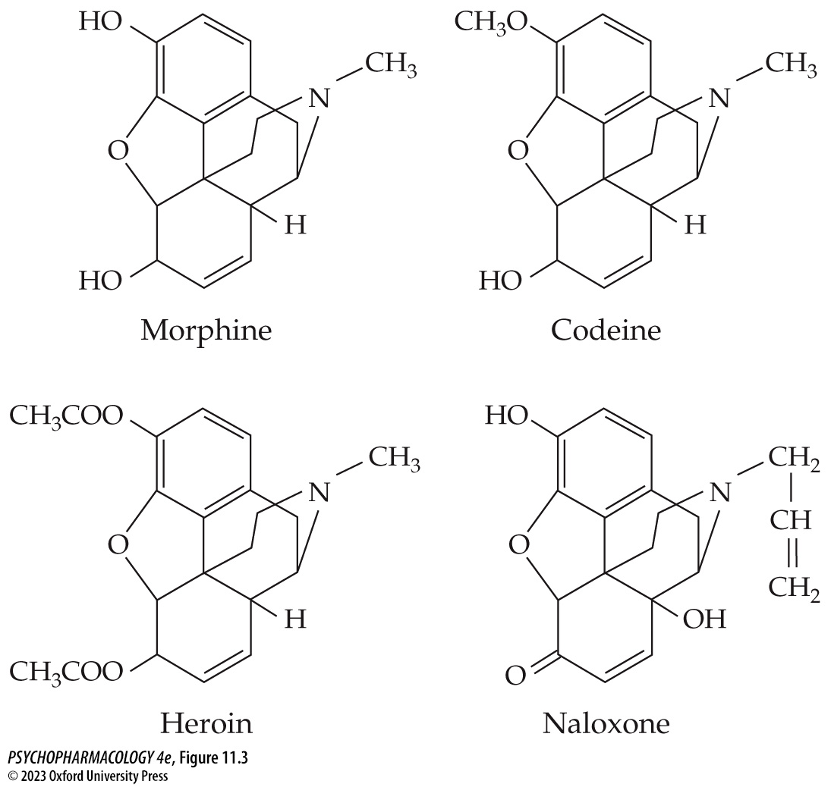
FIGURE 11.3 Molecular structure of morphine, codeine, heroin, and naloxone
Notes:
FIGURE 11.3 Molecular structure of morphine, codeine, heroin, and naloxone
It is easy to see the similarities in structure. The minor differences contribute to effectiveness and side effects.

Slide 10
Narcotic Analgesics (4 of 18)
Minor differences in molecular structure determine behavioral effects
Some modifications produce partial agonists – have less analgesic effect, but reduced risk of dependence
Other modifications produce neutral antagonists such as naloxone and nalorphine; can prevent or reverse the effect of opioids
Entirely synthetic opioids may have distinct structures
Notes:
Instructor Notes:

Slide 11
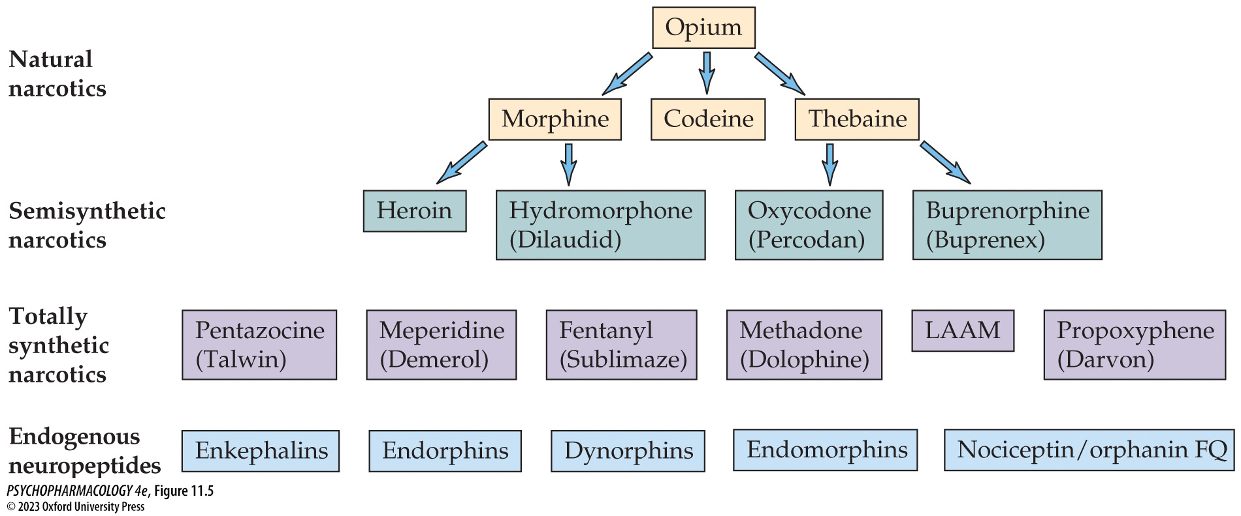
FIGURE 11.5 Relationship of selected natural and synthetic opioid drugs
Notes:
FIGURE 11.5 Relationship of selected natural and synthetic opioid drugs

Slide 12
Narcotic Analgesics (5 of 18)
Bioavailability predicts both physiological and behavioral effects
Only a small fraction of morphine crosses the blood–brain barrier.
Opioids easily cross the placenta. Newborns can suffer withdrawal symptoms but can be stabilized with low doses of opioids.
After metabolism in the liver, most opioid metabolites are excreted in the urine within 24 hours.
Notes:
Instructor Notes:

Slide 13
Narcotic Analgesics (6 of 18)
Opioids have their most important effects on the CNS and on the gastrointestinal tract
Effects of opioids on the CNS depend on dose and rate of absorption.
Low to moderate doses result in pain relief, constricted pupils, drowsiness, inability to concentrate, dreamy sleep
Some researchers suggest morphine relieves anxiety, aggressiveness, and feelings of inadequacy, which may lead to more drug use.
At higher doses, there is an abnormal state of elation or euphoria, which acts as a powerful reinforcer
Notes:
Instructor Notes:

Slide 14
Narcotic Analgesics (7 of 18)
Opioids have their most important effects on the CNS and on the gastrointestinal tract
Adverse effects: dysphoria, restlessness and anxiety, nausea and vomiting; morphine affects the area postrema in the brainstem that elicits vomiting.
At highest doses, sedative effects may lead to unconsciousness; body temperature and blood pressure fall; pupils become very constricted.
Morphine acts on the brainstem’s respiratory center; respiratory failure is the ultimate cause of death in overdose.
Notes:
Instructor Notes:

Slide 15
Narcotic Analgesics (8 of 18)
Opioids have their most important effects on the CNS and on the gastrointestinal tract
Opium and morphine have been used to treat diarrhea and can be life-saving in severe bacterial and parasitic diseases.
When opioids are used for pain management, constipation is a common side effect.
Modified opioid molecules such as loperamide are now used to treat diarrhea
Opioid addicts take very high doses of loperamide to produce euphoria and reduce withdrawal symptoms
Notes:
Instructor Notes:

Slide 16
Narcotic Analgesics (9 of 18)
Opioid receptors and endogenous neuropeptides
Molecular structure of morphine and its derivatives indicated probable structural features of opioid receptors
Naloxone’s blocking effects can be overcome by increasing concentrations of morphine, showing competition for the receptor
Not long after opioid receptors were identified, the natural neuropeptide ligands that act at the receptors were characterized
Notes:
Instructor Notes:

Slide 17
Narcotic Analgesics (10 of 18)
Receptor binding studies identified and localized opioid receptors
Opioid receptors were identified by radioligand binding methods
Receptors identified met the criteria for identification: specificity, saturability, reversibility and high affinity, and biological relevance
The relative potency of various opioids in competition experiments paralleled their relative potencies in pharmacological effects on the intestine
Notes:
Instructor Notes:

Slide 18
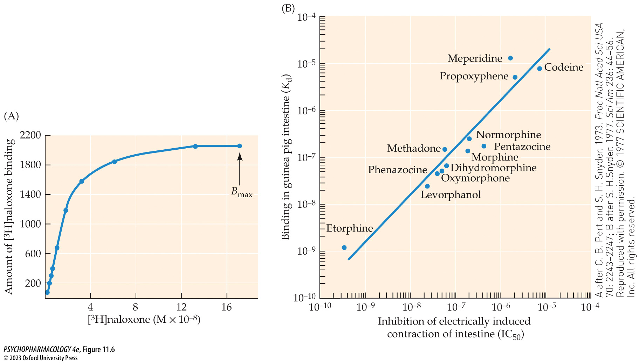
FIGURE 11.6 Opioid receptor binding
Notes:
FIGURE 11.6 Opioid receptor binding
(A) Binding of [³H]naloxone to rat brain shows the saturation of opioid receptors. As the concentration of the opioid ligand (naloxone) increases, binding to the receptors increases steadily until the receptors are filled at B_{max}. (B) There is a strong positive correlation between the concentration of opioid drugs needed to inhibit electrically induced contraction of the intestine (IC₅₀) and the concentration needed to bind to opioid receptors in the same tissue. The results show clearly that drugs that bind readily at low concentrations of ligand (e.g., etorphine) also are effective in inhibiting the intestinal contraction at low doses. Drugs that bind less well (e.g., codeine) also require higher concentrations to inhibit the contraction. (A after C. B. Pert and S. H. Snyder. 1973. Proc Natl Acad Sci USA 70: 2243–2247; B after S. H. Snyder. 1977. Sci Am 236: 44–56. Reproduced with permission. © 1977 SCIENTIFIC AMERICAN, Inc. All rights reserved.)

Slide 19
Narcotic Analgesics (11 of 18)
Four opioid receptor subtypes exist
Selective radioligands were used to identify receptor subtypes: μ, δ, κ, and the nociceptin/orphanin FQ receptor (NOP-R)
Opioids don’t bind to NOP-R, nor does nociceptin/orphanin FQ bind to classical opioid receptors
μ-receptor has a high affinity for morphine; have wide distribution in the brain and spinal cord
Notes:
Instructor Notes:

Slide 20
Narcotic Analgesics (12 of 18)
Four opioid receptor subtypes exist
δ-receptors are predominantly found in forebrain structures; consistent with roles in modulating olfaction, motor integration, reinforcement, and cognitive function
κ-receptors are found in the striatum and amygdala, hypothalamus and pituitary; may participate in regulation of pain perception, gut motility, and dysphoria.
Notes:
Instructor Notes:

Slide 21
Narcotic Analgesics (13 of 18)
Four opioid receptor subtypes exist
NOP-R are widely distributed in the CNS and PNS; receptor localization suggests a role in analgesia, feeding, learning, motor function, and neuroendocrine regulation
Receptor cloning and molecular sequencing established DNA and amino acid sequences.
In situ hybridization with radiolabeled genetic material shows localization of receptor types in the brain.
All four receptors are similar to proteins linked to G proteins (metabotropic)
Notes:
Instructor Notes:
Receptor cloning: genetic material is isolated and inserted into a cell (transfection), maintained in culture to produce identical cells

Slide 22
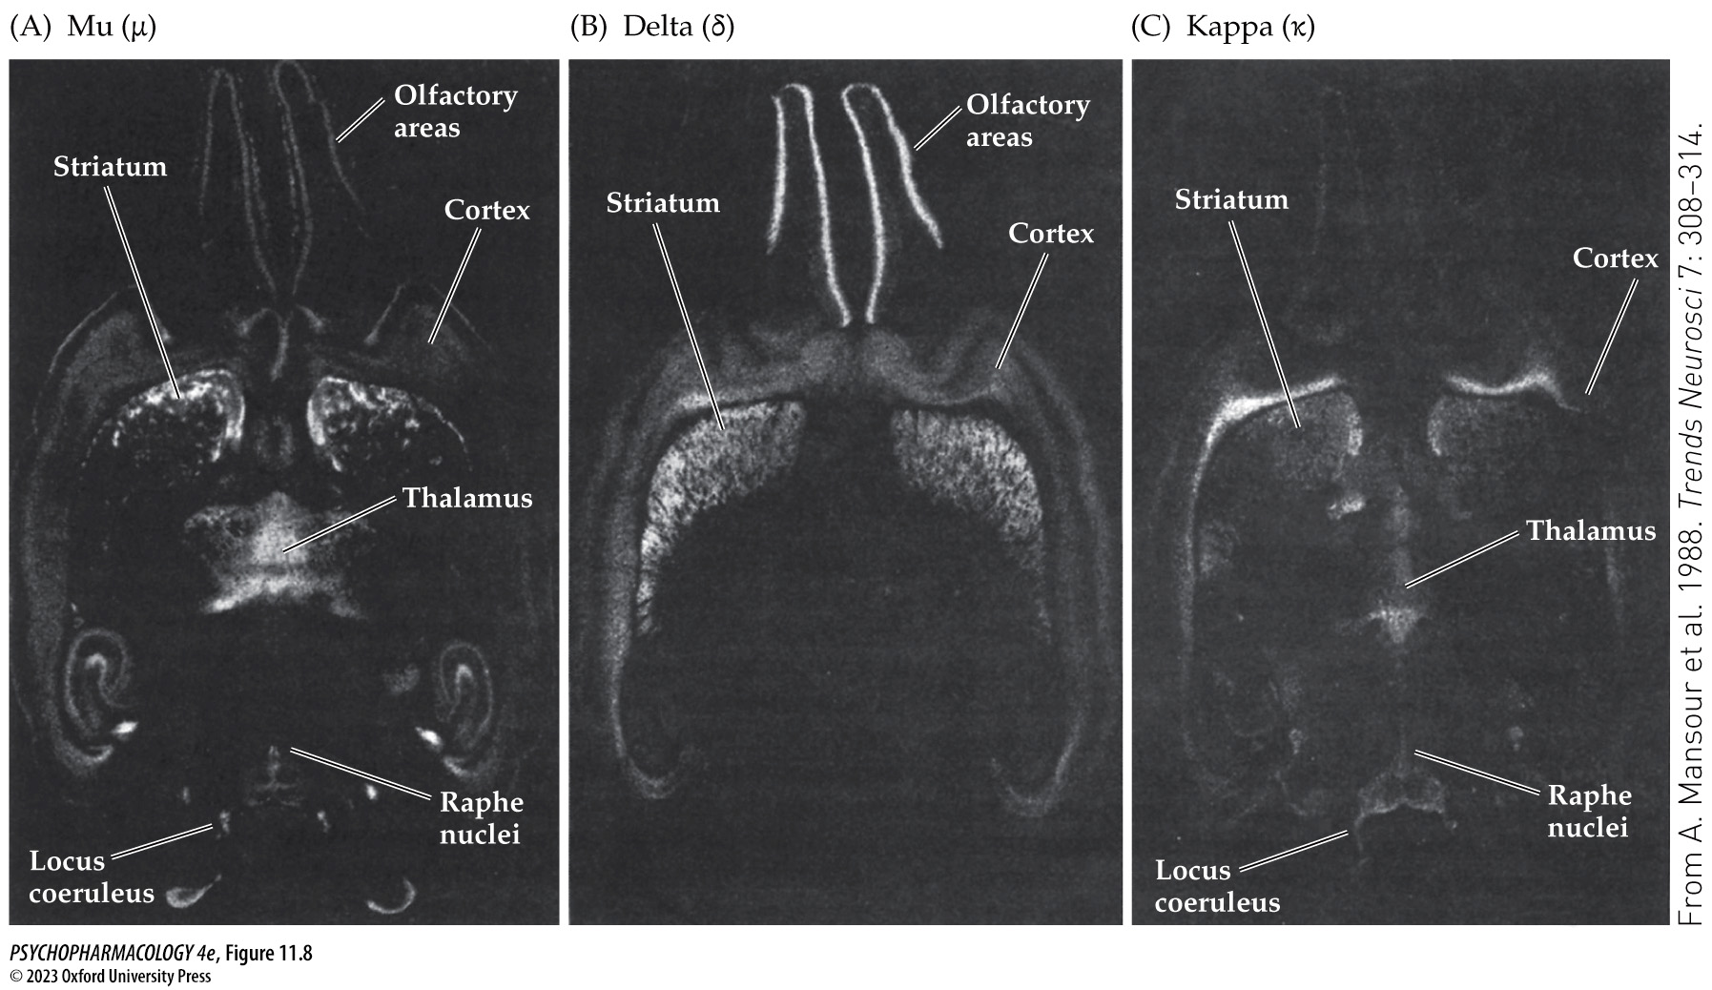
FIGURE 11.8 Autoradiograms of opioid receptor subtype binding in rat brain
Notes:
FIGURE 11.8 Autoradiograms of opioid receptor subtype binding in rat brain
Notice the distinct locations of (A) μ-, (B) δ-, and (C) κ-receptors.

Slide 23
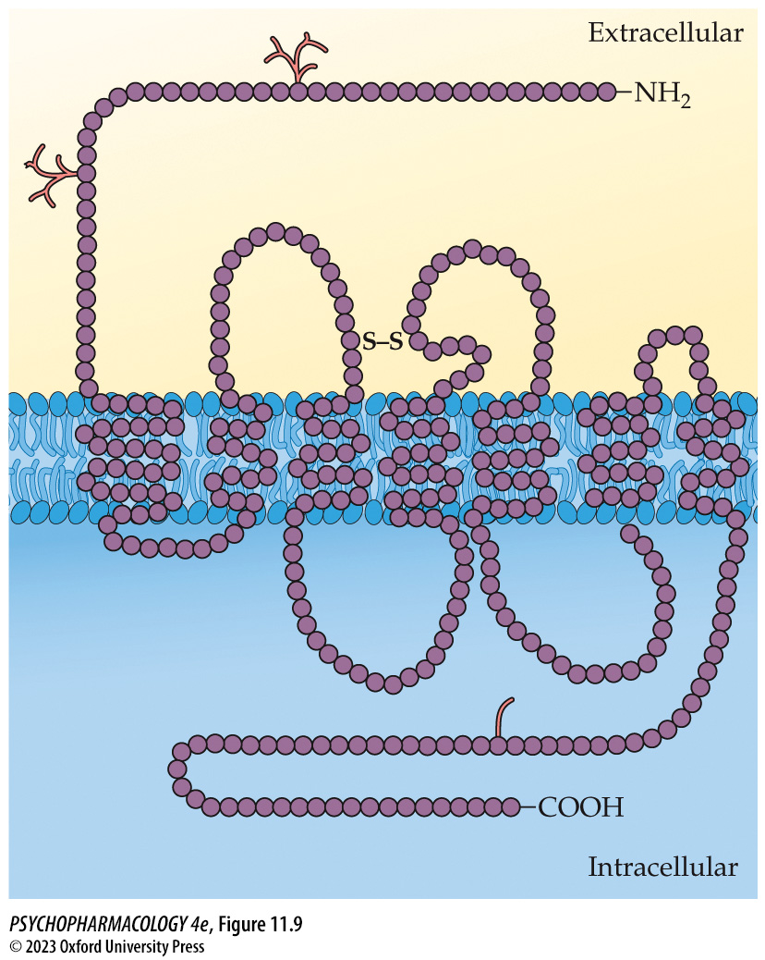
FIGURE 11.9 Proposed structure of the δ-opioid receptor
Notes:
FIGURE 11.9 Proposed structure of the δ-opioid receptor
Each circle represents an identified amino acid. The seven regions spanning the cell membrane are typical for receptors that are coupled to G proteins.

Slide 24
Narcotic Analgesics (14 of 18)
BOX 11.1 THE CUTTING EDGE
Science in Action
Membrane protein crystallization technology has determined the crystal structure of all four opioid receptor types.
Understanding the details of receptor structure and ligand-receptor binding will result in structure-based drug design.
PZM21 was found to act on the μ-opioid receptor and had analgesic effect in mice. Effects lasted longer than morphine, with fewer side effects.
Notes:
Instructor Notes:

Slide 25
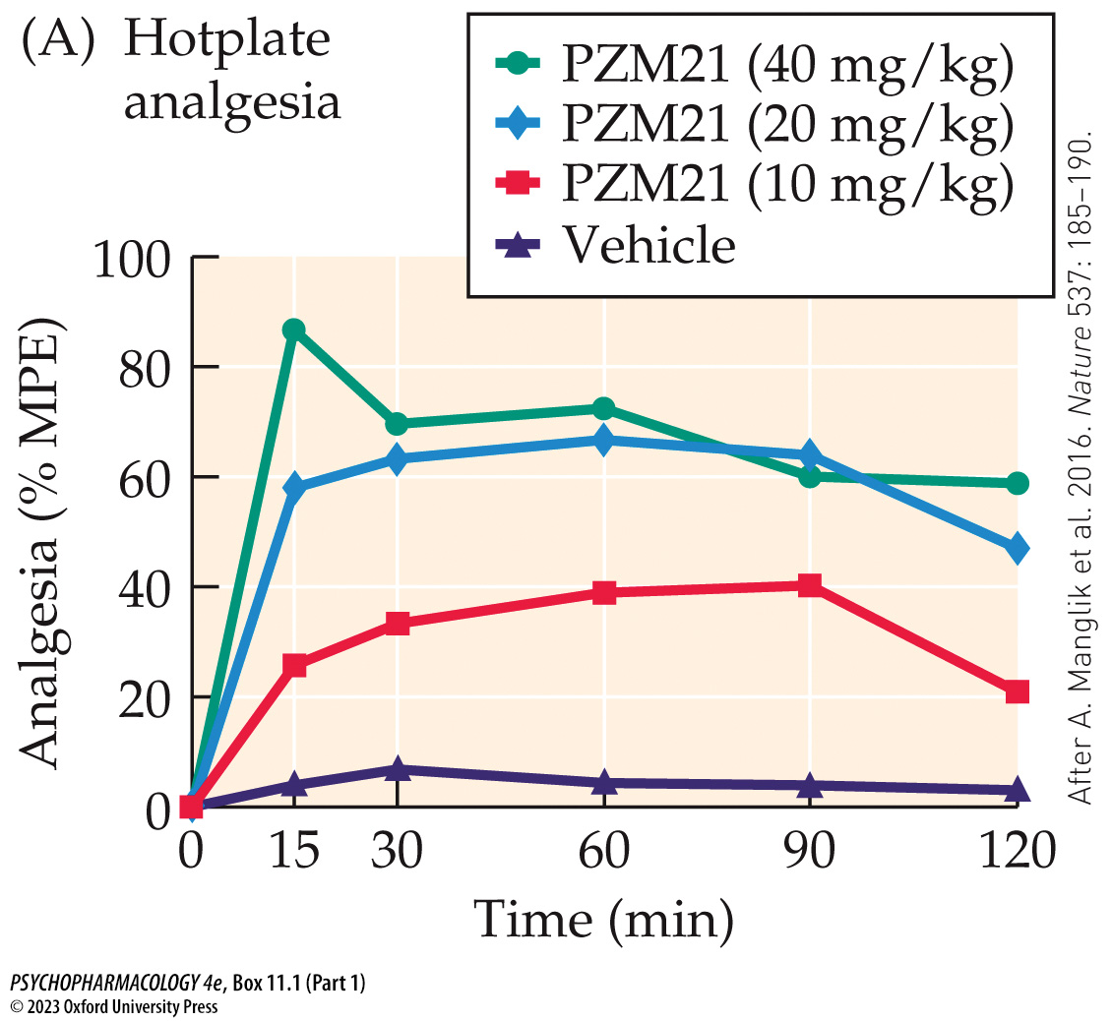
Box 11.1 The Cutting Edge: Science in Action (Part 1)
Notes:
Box 11.1 The Cutting Edge: Science in Action
FIGURE A PZM21 is an effective analgesic with reduced side effects
(A) Dose–response curves for PZM21-induced analgesia (left) and morphine-induced analgesia (right). Latency to withdraw from a heated surface in the hotplate test is expressed as a percentage of the maximal possible effect (% MPE). The x-axis represents the time after subcutaneous administration of drug or saline (vehicle). The analgesic effect of 40 mg/kg of PZM21 was comparable to the effect of 10 mg/kg of morphine. (After A. Manglik et al. 2016. Nature 537: 185–190.)

Slide 26
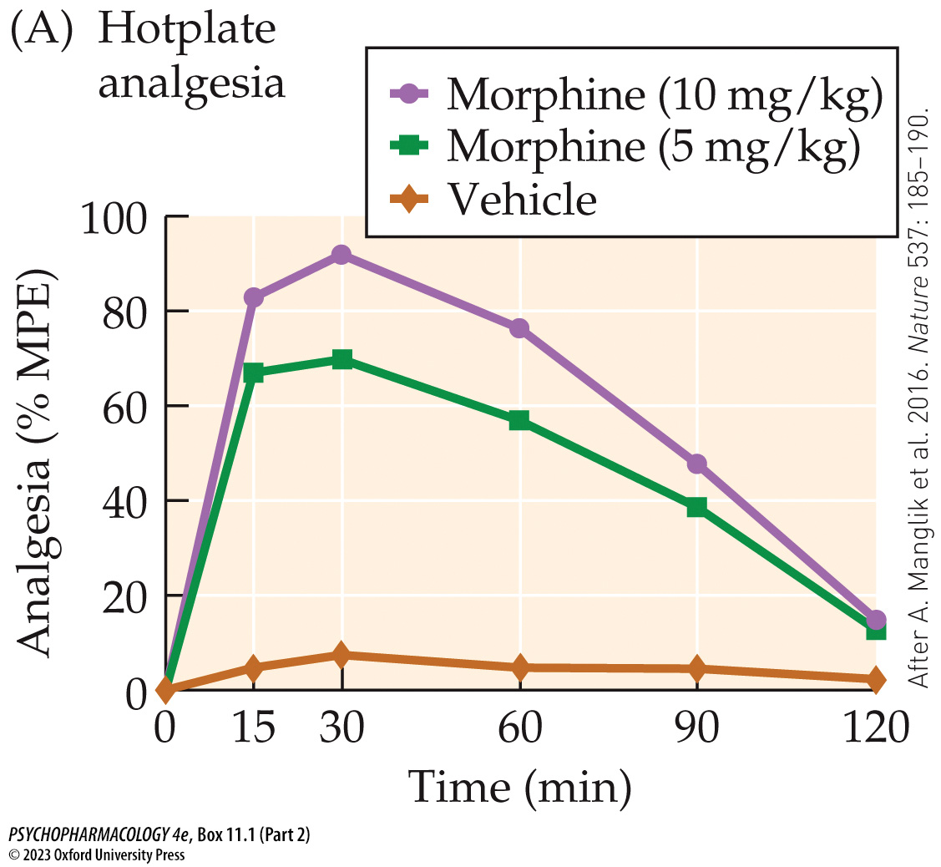
Box 11.1 The Cutting Edge: Science in Action (Part 2)
Notes:
Box 11.1 The Cutting Edge: Science in Action
FIGURE A PZM21 is an effective analgesic with reduced side effects
(A) Dose–response curves for PZM21-induced analgesia (left) and morphine-induced analgesia (right). Latency to withdraw from a heated surface in the hotplate test is expressed as a percentage of the maximal possible effect (% MPE). The x-axis represents the time after subcutaneous administration of drug or saline (vehicle). The analgesic effect of 40 mg/kg of PZM21 was comparable to the effect of 10 mg/kg of morphine. (After A. Manglik et al. 2016. Nature 537: 185–190.)

Slide 27
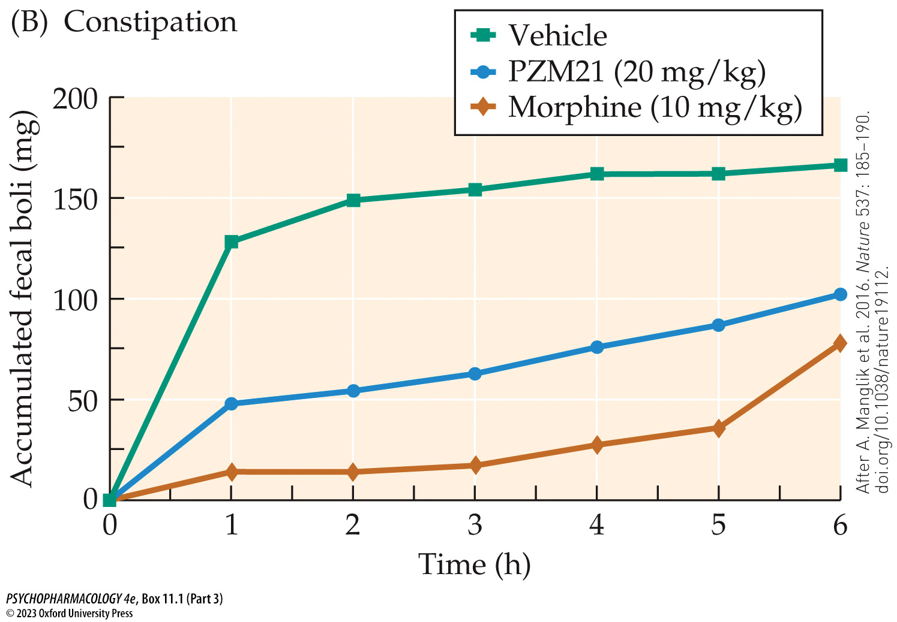
Box 11.1 The Cutting Edge: Science in Action (Part 3)
Notes:
Box 11.1 The Cutting Edge: Science in Action
FIGURE B-D PZM21 is an effective analgesic with reduced side effects
(B) Defecation (mg of fecal boli) was less after PZM21 administration than with saline, indicating constipation, but not as severe as with morphine. (C) About 20 minutes after administration, respiration frequency was significantly lower in subjects treated with morphine than in those receiving saline, while an equally analgesic dose of PZM21 did not impair respiration frequency. (D) Animals conditioned to associate a particular chamber with morphine rather than saline administration showed a preference for that chamber. Animals trained with PZM21 and saline failed to show such a place preference. (After A. Manglik et al. 2016. Nature 537: 185–190. doi.org/10.1038/nature19112.)

Slide 28
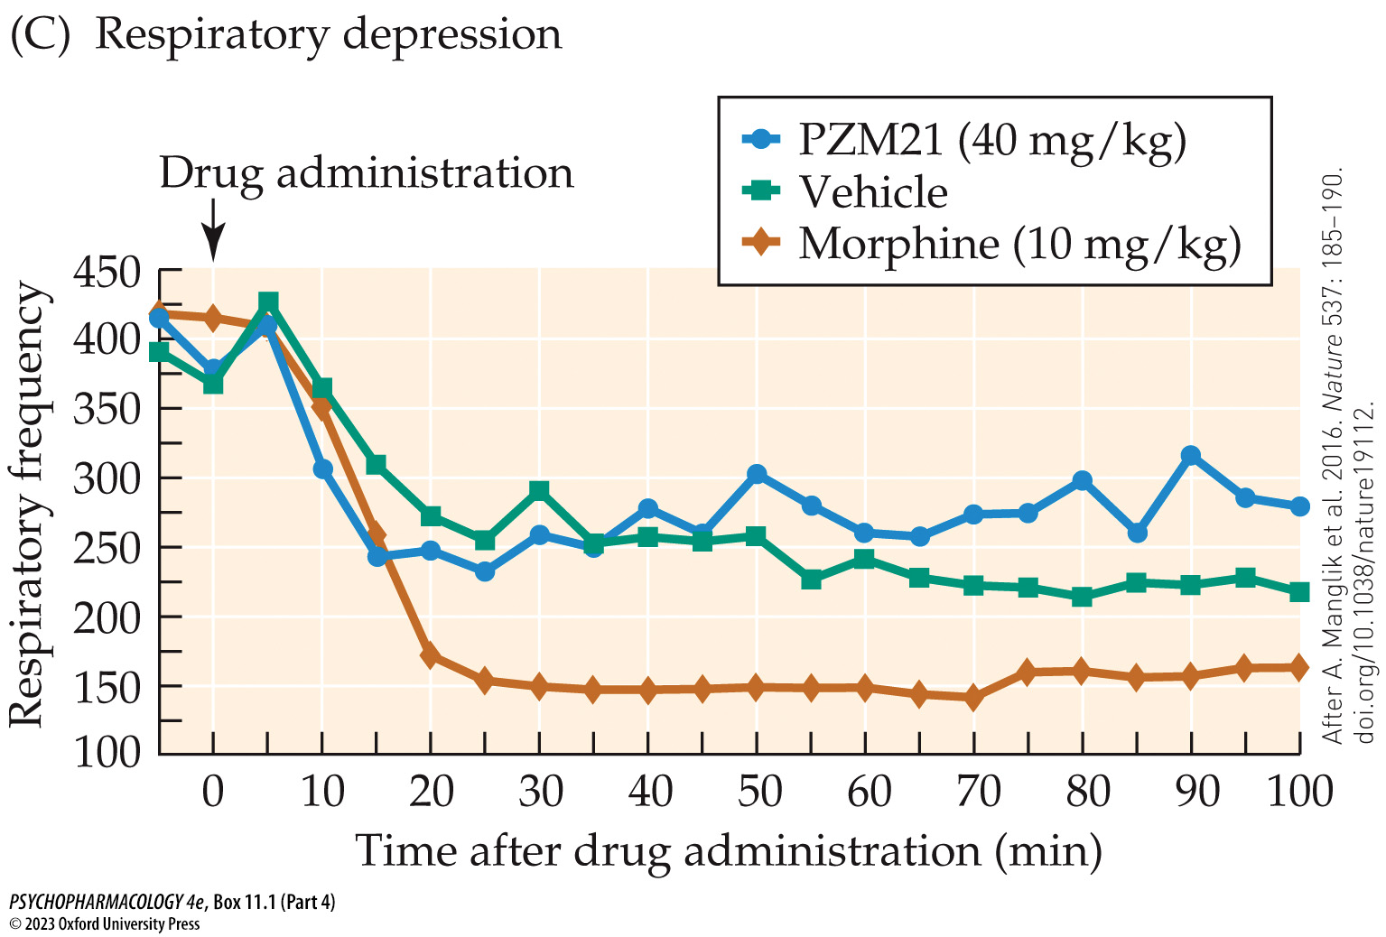
Box 11.1 The Cutting Edge: Science in Action (Part 4)
Notes:
Box 11.1 The Cutting Edge: Science in Action
FIGURE B-D PZM21 is an effective analgesic with reduced side effects
(B) Defecation (mg of fecal boli) was less after PZM21 administration than with saline, indicating constipation, but not as severe as with morphine. (C) About 20 minutes after administration, respiration frequency was significantly lower in subjects treated with morphine than in those receiving saline, while an equally analgesic dose of PZM21 did not impair respiration frequency. (D) Animals conditioned to associate a particular chamber with morphine rather than saline administration showed a preference for that chamber. Animals trained with PZM21 and saline failed to show such a place preference. (After A. Manglik et al. 2016. Nature 537: 185–190. doi.org/10.1038/nature19112.)

Slide 29
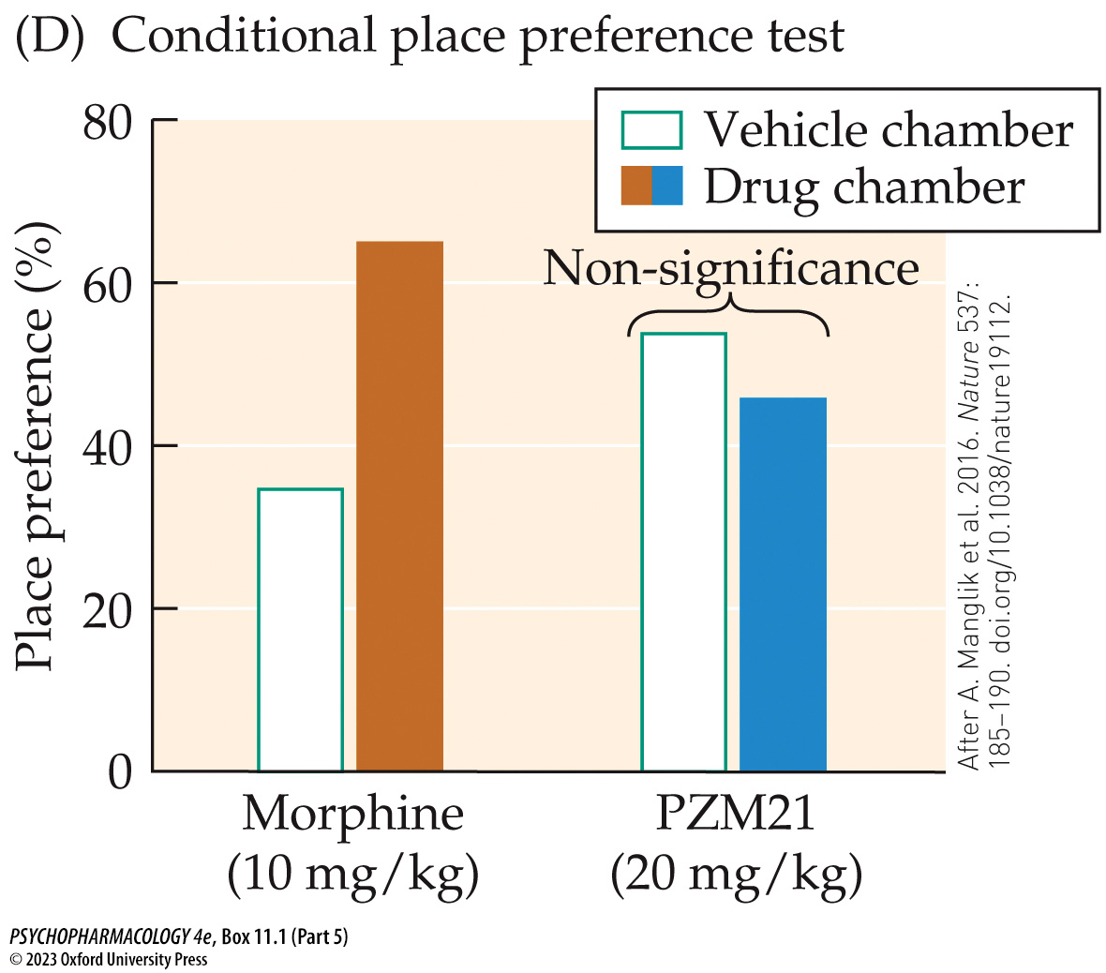
Box 11.1 The Cutting Edge: Science in Action (Part 5)
Notes:
Box 11.1 The Cutting Edge: Science in Action
FIGURE B-D PZM21 is an effective analgesic with reduced side effects
(B) Defecation (mg of fecal boli) was less after PZM21 administration than with saline, indicating constipation, but not as severe as with morphine. (C) About 20 minutes after administration, respiration frequency was significantly lower in subjects treated with morphine than in those receiving saline, while an equally analgesic dose of PZM21 did not impair respiration frequency. (D) Animals conditioned to associate a particular chamber with morphine rather than saline administration showed a preference for that chamber. Animals trained with PZM21 and saline failed to show such a place preference. (After A. Manglik et al. 2016. Nature 537: 185–190. doi.org/10.1038/nature19112.)

Slide 30
Narcotic Analgesics (15 of 18)
Several families of naturally occurring opioid peptides bind to these receptors
Endogenous opioids (endorphins) plus non-opioid peptides are formed from larger propeptides (precursor peptides):
  Prodynorphin
  Pro-opiomelanocortin or POMC
  Proenkephalin
  Pronociceptin/orphanin FQ
The propeptides are concentrated in areas related to pain modulation and mood.
Notes:
Instructor Notes:
Endomorphins: peptides with a distinct structure and distribution in the CNS; bind selectively to the μ-receptor and are as potent as morphine in relieving pain. The propeptide has not been identified.

Slide 31
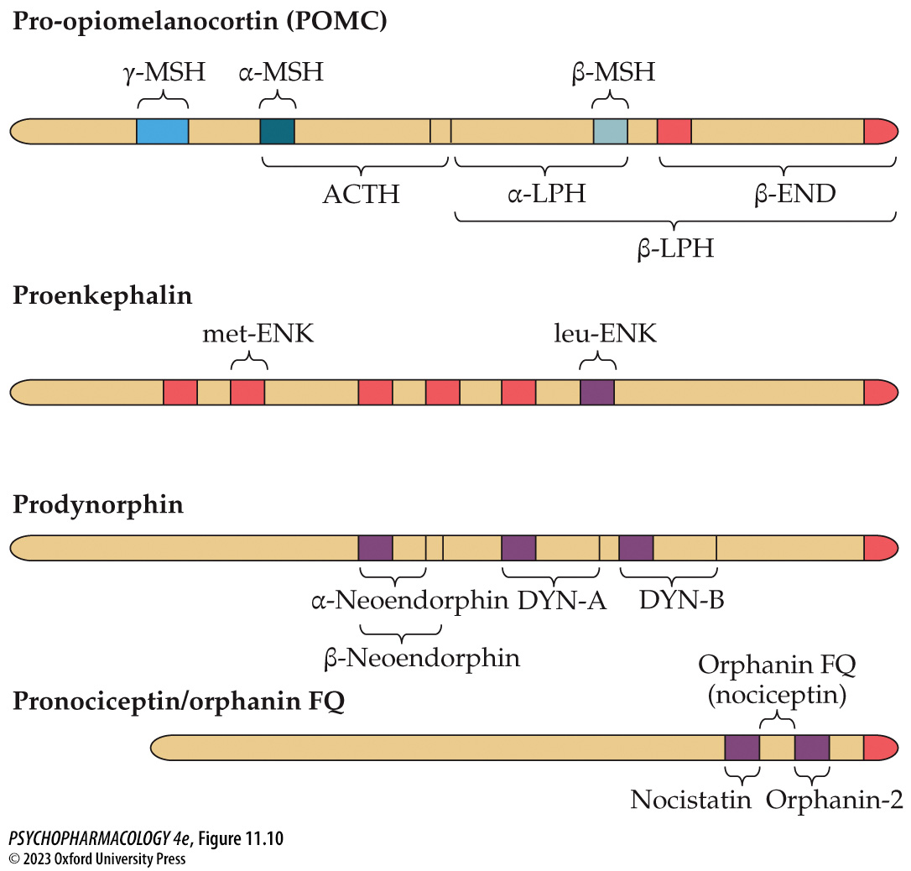
FIGURE 11.10 The four opioid propeptides and some of their possible products
Notes:
FIGURE 11.10 The four opioid propeptides and some of their possible products
POMC is cleaved into β-endorphin (β-END) and a number of other peptides, including γ- and α-melanocyte-stimulating hormone (MSH), β-MSH, adrenocorticotropic hormone (ACTH), and several forms of lipotropin (LPH). Pro­enkephalin cleavage produces several copies of met- and leu-enkephalin (ENK). Prodynorphin contains α- and β-neoendorphin, as well as dynorphin (DYN) A and B. Pronociceptin/orphanin FQ cleavage produces one copy each of orphanin FQ, orphanin-2, and nocistatin. Tiny enkephalin peptides are also frequently found within the larger peptide fragments.

Slide 32
Narcotic Analgesics (16 of 18)
Several families of naturally occurring opioid peptides bind to these receptors
POMC is concentrated in the pituitary gland.
CRF is released from the hypothalamus in response to stress; increases ACTH release from the pituitary and ultimately glucocorticoids from the adrenal cortex.
CRF also causes rapid increase in POMC mRNA and subsequent increase in release of β-endorphin from the pituitary.
Many types of stressors increase both CRF and POMC, suggesting a link between pain and stress regulation.
Notes:
Instructor Notes:
CRF: Corticotropin-releasing factor

Slide 33
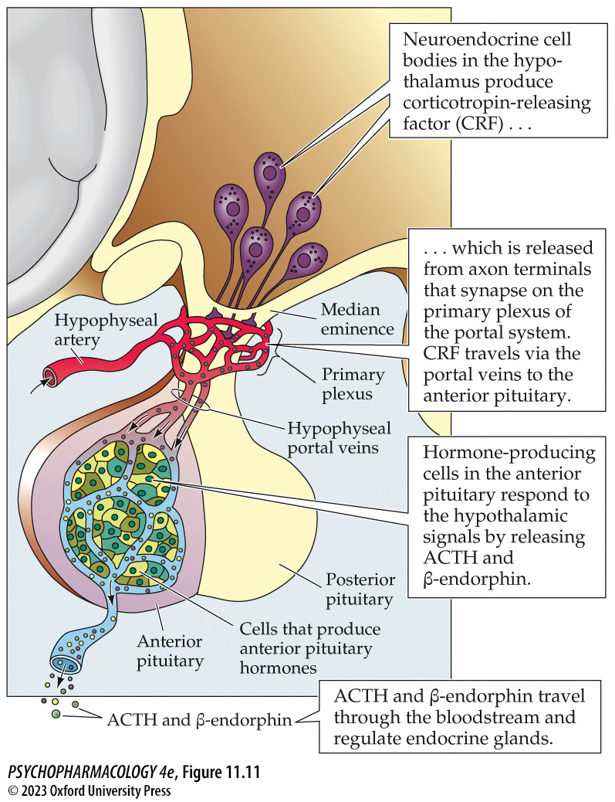
FIGURE 11.11 Hypothalamic control of ACTH and β-endorphin release (1)
Notes:
FIGURE 11.11 Hypothalamic control of ACTH and β-endorphin release
The hypothalamus releases CRF, which causes the anterior pituitary to secrete ACTH, which in turn acts on the adrenal gland to prepare the individual to deal with stress. CRF also influences β-endorphin synthesis and release from the pituitary in response to stress. Notice in Figure 11.10 that ACTH and β-endorphin come from the same propeptide, POMC.

Slide 34
Narcotic Analgesics (17 of 18)
Opioid receptor–mediated cellular changes are inhibitory
Opioids and N/OFQ work through G proteins and second messengers to reduce synaptic transmission
Postsynaptic inhibition: opens K⁺ channels - hyperpolarization
Axoaxonic inhibition: closes calcium Ca²⁺ channels – decreases amount of transmitter released
Presynaptic autoreceptors: reduce release of a co-localized transmitter
Inhibition of adenylyl cyclase
Notes:
Instructor Notes:

Slide 35
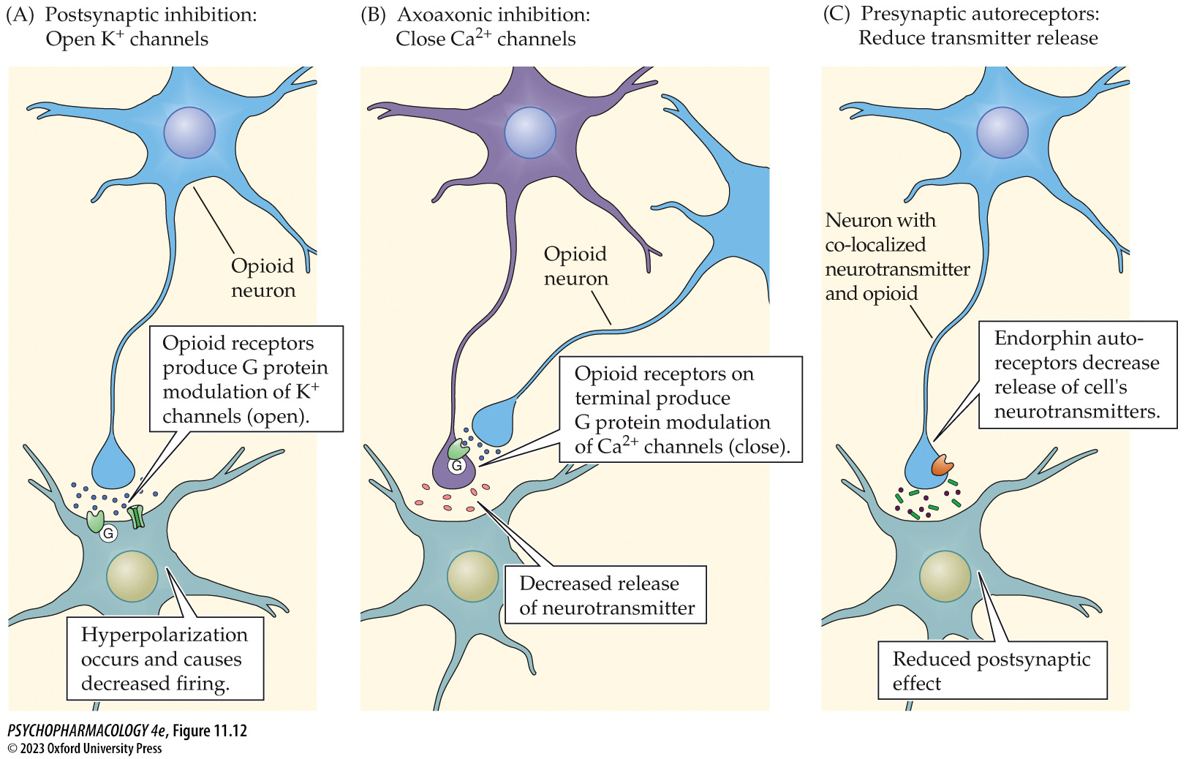
FIGURE 11.12 Inhibitory actions of endogenous opioids (1)
Notes:
FIGURE 11.12 Inhibitory actions of endogenous opioids
Opioids inhibit nerve activity in several ways. (A) Opioids bind to receptors that activate a G protein that opens K⁺ channels to hyperpolarize the postsynaptic cells, thereby reducing the rate of firing. (B) Opioid receptors on nerve terminals (axo­axonic) activate G proteins that close Ca²⁺ channels, reducing the release of the neurotransmitter. (C) Presynaptic autoreceptors activate G proteins and reduce the release of a co-localized neurotransmitter. The mechanism may involve closing Ca²⁺ channels or opening K⁺ channels that hyperpolarize the presynaptic cell.

Slide 36
Narcotic Analgesics (18 of 18)
CLICKER QUESTION 1
What method was used to determine the 3-dimensional structure of the opioid receptors?
Receptor cloning
Autoradiography
Receptor binding studies
Membrane protein crystallization
Notes:
Instructor Notes:
Correct answer: d

Slide 37
Review of Learning Objectives (1 of 3)
11.1.1 Describe how opiates are cultivated and explain the distinction between opiates and opioids.
11.1.2 Describe the behavioral and physiological effects of opioids at therapeutic and toxic doses.
11.1.3 Identify and briefly describe the four types of opioid receptors.
11.1.4 Describe the endogenous opioids and identify the propeptides that they are derived from.

Slide 38
Opioids and Pain (1 of 7)
The two components of pain have distinct features
First (early) pain—immediate, sensory component; signal carried by myelinated Aδ neurons – conduct action potentials rapidly; transmitted from spinal cord via spinothalamic tract to PVL nucleus of the thalamus, then the somatosensory cortex
Second (late) pain—emotional component; signal carried by thin, unmyelinated C fibers; transmission is slower; goes to the thalamus, but gives off collaterals to a several limbic structures and the anterior cingulate cortex.
Notes:
Instructor Notes:
Nociceptors: networks of free nerve endings that are sensitive to intense pressure, extreme temperature including heat and cold, electrical impulses, cuts, chemical irritants, and inflammation.

Slide 39
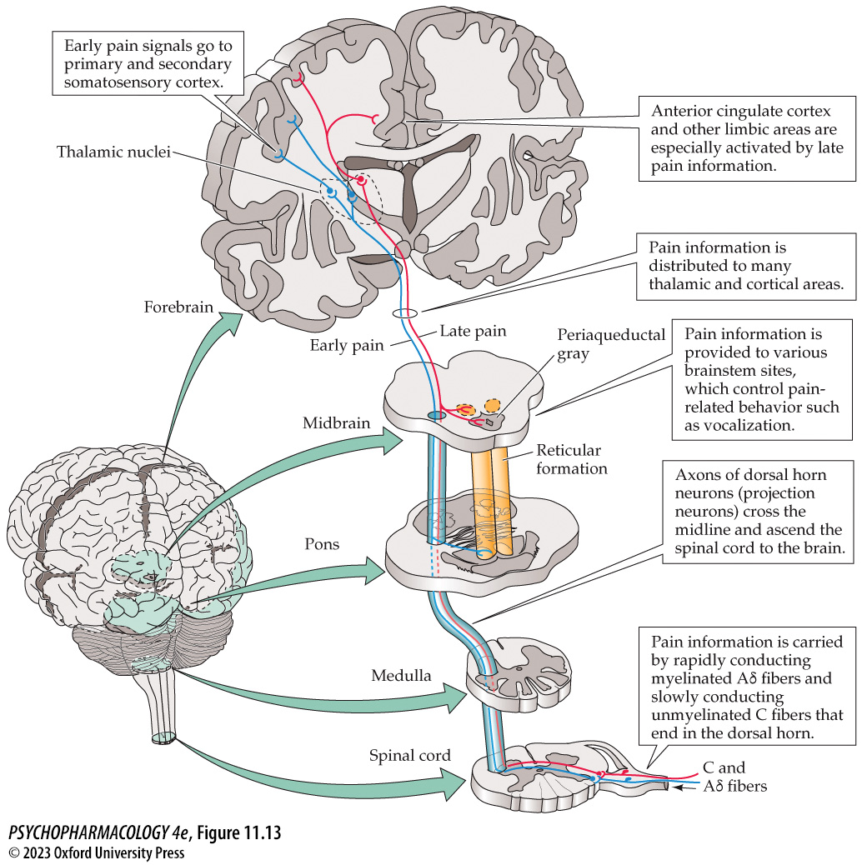
FIGURE 11.13 Ascending pain pathways
Notes:
FIGURE 11.13 Ascending pain pathways
Sensory neurons (Aδ and C fibers) activated by noxious stimuli enter the dorsal horn of the spinal cord. Dorsal horn neurons travel up the spinal cord on the contralateral side and ultimately reach various nuclei in the thalamus. Neurons transmitting “early” (first) pain end first in the primary somatosensory cortex for well-localized sensory discrimination, before the information is transferred to the secondary somatosensory cortex, where pain recognition occurs. The slower-conducting neurons transmit information (second pain) to a variety of limbic areas, including the anterior cingulate cortex, which is important for the emotional or suffering aspect of pain.

Slide 40
Opioids and Pain (2 of 7)
The two components of pain have distinct features
Location and time course of pain-evoked neural activity in humans is studied using magnetoencephalography (MEG)
First pain (pain recognition) was temporally related to activation of the primary somatosensory cortex.
Second pain was strongly associated with anterior cingulate activation.
Both types were associated with activity in the secondary somatosensory cortex.
Notes:
Instructor Notes:

Slide 41
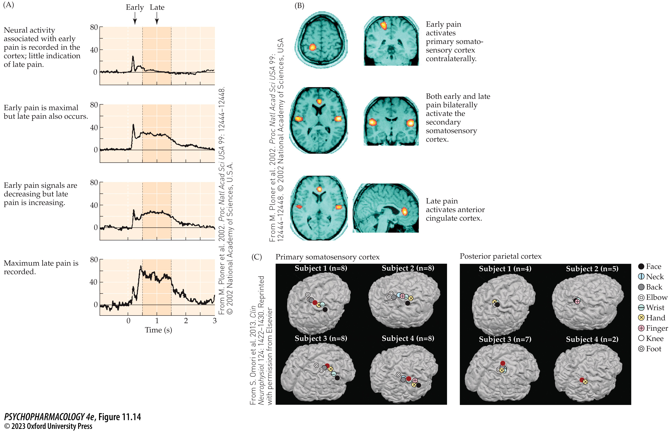
FIGURE 11.14 Location and time course of pain-evoked neural activity in humans
Notes:
FIGURE 11.14 Location and time course of pain-evoked neural activity in humans
(A) Sequential MEG tracings of the changes in cortical magnetic fields over 3 seconds following the initiation of the painful stimulus. (B) Brain areas that are active at corresponding points in time are shown as light-shaded areas that have been superimposed on magnetic resonance images. (C) Adjacent areas of primary somatosensory cortex are responsive to application of correspondingly adjacent painful stimuli on the body. (A from M. Ploner et al. 2002. Proc Natl Acad Sci USA 99: 12444–12448. © 2002 National Academy of Sciences, U.S.A.)

Slide 42
Opioids and Pain (3 of 7)
Opioids inhibit pain transmission at spinal and supraspinal levels
Opioid drugs mimic the inhibitory action of endogenous opioids
Opioids reduce transmission of pain signals at the spinal cord in two ways:
  Inhibitory spinal interneurons release endorphins that inhibit activation of spinal projection neurons
  Descending modulatory pathways - inhibit projection neuron or excitatory interneuron, or excite inhibitory opioid neuron; most important pathway originates in the PAG in the midbrain
Notes:
Instructor Notes:
PAG: periaqueductal gray

Slide 43
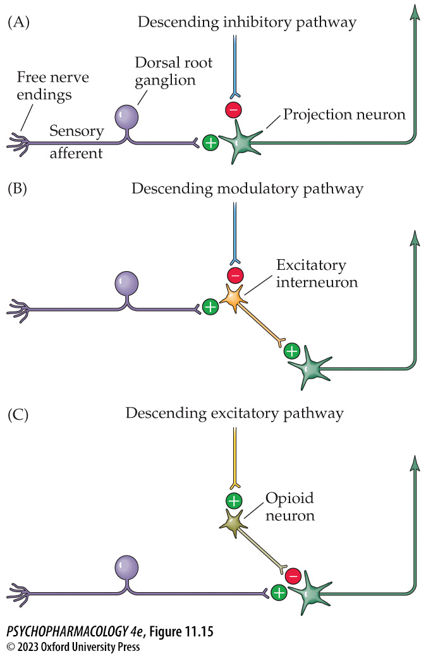
FIGURE 11.15 Pain transmission in the spinal cord
Notes:
FIGURE 11.15 Pain transmission in the spinal cord
Descending modulatory neurons modify transmission via (A) inhibition of the projection neuron, (B) inhibition of an excitatory interneuron, and (C) excitation of an inhibitory opioid interneuron. Opioid drugs can influence the activity of the descending pathways and can act directly on opioid receptors in the spinal cord.

Slide 44
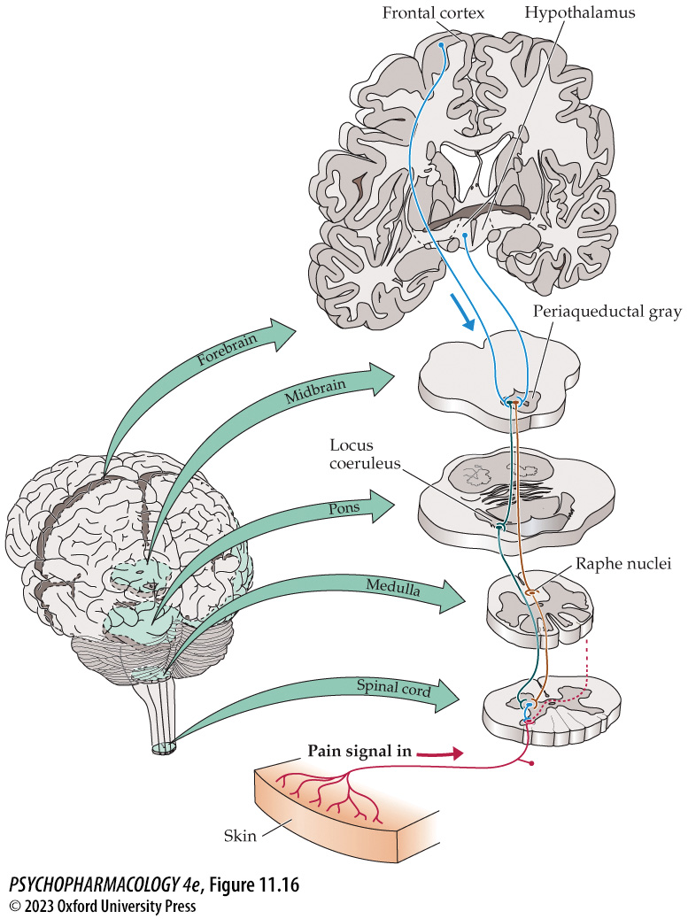
FIGURE 11.16 Descending pain modulation pathways
Notes:
FIGURE 11.16 Descending pain modulation pathways
Neurons from the periaqueductal gray descend to the brainstem nucleus of the raphe (serotonergic neurons) and the locus coeruleus (adrenergic neurons). The neurons in both pathways descend to the spinal cord to modulate the transmission of the pain signal at that level.

Slide 45
Opioids and Pain (4 of 7)
Opioids inhibit pain transmission at spinal and supraspinal levels
Opioid activity also occurs in supraspinal locations, including sensory areas, limbic structures, and hypothalamus; may be responsible for the emotional component of pain
PET imaging showed significant negative correlation between μ-opioid activity in the NAcc, amygdala, and thalamus and reported sensory pain scores.
Notes:
Instructor Notes:

Slide 46
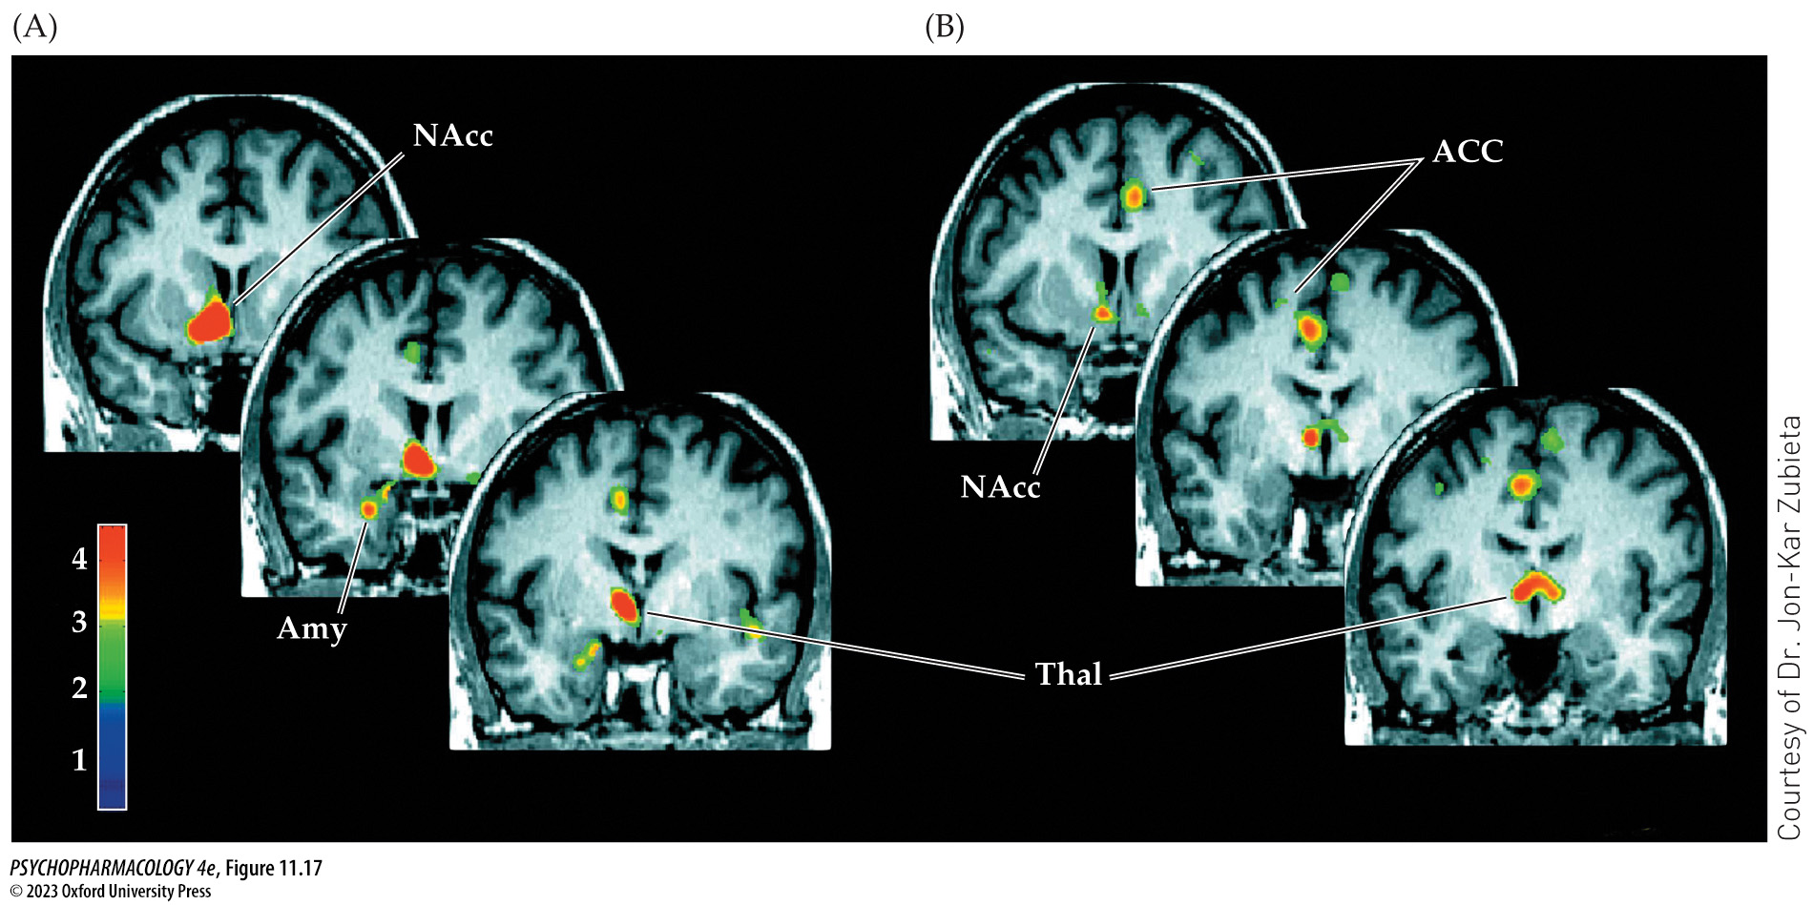
FIGURE 11.17 PET scans showing endogenous opioid activation during sustained pain
Notes:
FIGURE 11.17 PET scans showing endogenous opioid activation during sustained pain
In study participants injected with [¹¹C]carfentanil, endogenous opioid action is shown by the ability of the endogenous opioid to displace the radiolabeled μ-receptor ligand from the receptors. Pain was induced by continuous infusion of hypertonic saline in the masseter muscle and was compared with a control condition of isotonic saline infusion. (A) Activation of the μ-opioid system in the nucleus accumbens (NAcc), amygdala (Amy), and anterior thalamus (Thal) after the participants were exposed to the prolonged noxious stimulus. The warmer colors indicate greater activation. These increases were negatively correlated with the participants’ sensory scores of pain. (B) μ-Opioid activity in the bilateral anterior cingulate cortex (ACC) and anterior thalamus and unilaterally in the NAcc. These increases were negatively correlated with pain affect scores. Therefore, the greater the μ-opioid activation in these areas, the lower was the emotional component of pain. Areas in red indicate greatest activity.

Slide 47
Opioids and Pain (5 of 7)
Opioids inhibit pain transmission at spinal and supraspinal levels
Several forms of pain control depend on opioids:
  Acupuncture: releases endogenous opioids
  Dual inhibition of peptidases: inhibit two enzymes that degrade enkephalin
  Gene therapy: gene for proenkephalin is introduced using a modified virus vector
Notes:
Instructor Notes:

Slide 48
Opioids and Pain (6 of 7)
Opioids inhibit pain transmission at spinal and supraspinal levels
Several forms of pain control depend on opioids:
  Dual μ-receptor/NOP-R agonists: NOP-R stimulation will reduce some of the pain so less μ-receptor stimulation will be needed; fewer side effects
  Biased opioid agonists: drugs selectively target opioid receptors in different constitutive states or in peripheral tissue; induces analgesia without side effects mediated by the CNS
Notes:
Instructor Notes:

Slide 49
Opioids and Pain (7 of 7)
CLICKER QUESTION 2
The main descending pathway that modifies pain information from the spinal cord originates in which structure?
NAcc
Thalamus
PAG
Anterior cingulate cortex
Notes:
Instructor Notes:
Correct answer: c

Slide 50
Review of Learning Objectives (2 of 3)
11.2.1 Describe how pain is initially perceived and explain how early and late pain signals are transmitted to the brain.
11.2.2 Explain how opioids interfere with neural pain signals to produce analgesia.
11.2.3 Describe other forms of pain control that rely on the endogenous opioid system.

Slide 51
Opioid Reinforcement, Tolerance, and Dependence (1 of 15)
Opioids have significant reinforcing properties and chronic use leads to tolerance and physical dependence.
Predicting which patients might become addicted is difficult; in future, pharmacogenetic testing may provide answers
CDC guidelines that limit use of opioids for pain control are aimed at reducing opioid misuse and deaths that often begin with prescription drugs
Notes:
Instructor Notes:

Slide 52
Opioid Reinforcement, Tolerance, and Dependence (2 of 15)
Animal testing shows significant reinforcing properties
In animal studies, opioids lower the electrical current threshold for self-stimulation, indicating that the drugs enhance the brain reward mechanism.
Animals can learn to maintain stable blood levels by self-administration.
Reinforcement value and the pattern of opioid use in animals are quite similar to those seen in humans.
Notes:
Instructor Notes:

Slide 53
Opioid Reinforcement, Tolerance, and Dependence (3 of 15)
Dopaminergic and nondopaminergic components contribute to opioid reinforcement
Dopaminergic mesolimbic pathway: originates in the VTA of the midbrain and projects to limbic areas, including the NAcc
Opioid drugs inhibit inhibitory GABA cells, increasing mesolimbic cell firing and DA release in the NAcc.
The mesolimbic DA system may mediate aversive effects of opioids, as well as their reinforcing properties
Notes:
Instructor Notes:
VTA: ventral tegmental area
NAcc: nucleus accumbens

Slide 54
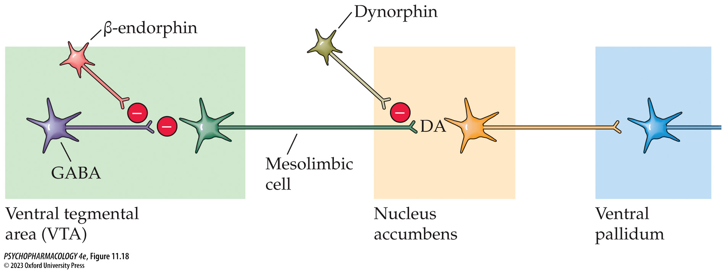
FIGURE 11.18 Model of the effects of opioids on mesolimbic dopaminergic cells
Notes:
FIGURE 11.18 Model of the effects of opioids on mesolimbic dopaminergic cells
The β-endorphin cell has an inhibitory effect on the normally inhibitory GABAergic cell, allowing the firing rate of the mesolimbic dopaminergic cells to increase and the cells to release more dopamine (DA) in the nucleus accumbens. In contrast, the axoaxonic dynorphin cell inhibits the release of dopamine from the mesolimbic cell by preventing calcium entry.

Slide 55
Opioid Reinforcement, Tolerance, and Dependence (4 of 15)
Long-term opioid use produces tolerance, sensitization, and dependence
Tolerance: diminishing effects of a drug with repeated use.
Cross-tolerance: related drugs also show reduced effectiveness
Sensitization: increase in drug effects with repeated administration; craving increases while liking may decrease
Physical dependence: neuroadaptive state in response to long-term occupation of opioid receptors
Notes:
Instructor Notes:

Slide 56
Opioid Reinforcement, Tolerance, and Dependence (5 of 15)
Long-term opioid use produces tolerance, sensitization, and dependence
Withdrawal or abstinence syndrome
When the drug is no longer present, cell function returns to normal but also overshoots basal levels
Opioids in general depress CNS function; opioid withdrawal is rebound hyperactivity.
Cross-dependence: administering any other opioid drug will stop or reduce withdrawal symptoms
Notes:
Instructor Notes:

Slide 57
Opioid Reinforcement, Tolerance, and Dependence (6 of 15)
BOX 11.2 OF SPECIAL INTEREST
The Opioid Epidemic
The most significant factor: misleading and aggressive marketing of OxyContin to doctors and patients by the maker, Perdue Pharma
OxyContin became a popular street drug, and abuse and overdoses spread around the country
Heroin and counterfeit pills are now being adulterated with illicitly manufactured fentanyl, 50 times more potent than heroin
Notes:
Instructor Notes:
sdsdfsd

Slide 58
Opioid Reinforcement, Tolerance, and Dependence (7 of 15)
Several brain areas contribute to the opioid abstinence syndrome
Animal models are used to determine which areas of the brain are involved in withdrawal signs.
The LC and PAG are particularly sensitive to opioid antagonists in terms of precipitating withdrawal
NAcc is important in reinforcement; may be important in aversive stimulus effects or motivational aspects of withdrawal
Notes:
Instructor Notes:
LC: locus coeruleus

Slide 59
Opioid Reinforcement, Tolerance, and Dependence (8 of 15)
Neurobiological adaptation and rebound constitute tolerance and withdrawal
Classic hypothesis of opioid tolerance and dependence (1943): nervous system adapts to a drug; tolerance develops; when drug is withdrawn, adaptation causes rebound effects.
Opioids acutely inhibit adenylyl cyclase and cAMP production but cAMP returns to normal (tolerance), at withdrawal, cAMP levels increase dramatically
Multiple cellular mechanisms are likely responsible for tolerance development
Notes:
Instructor Notes:

Slide 60
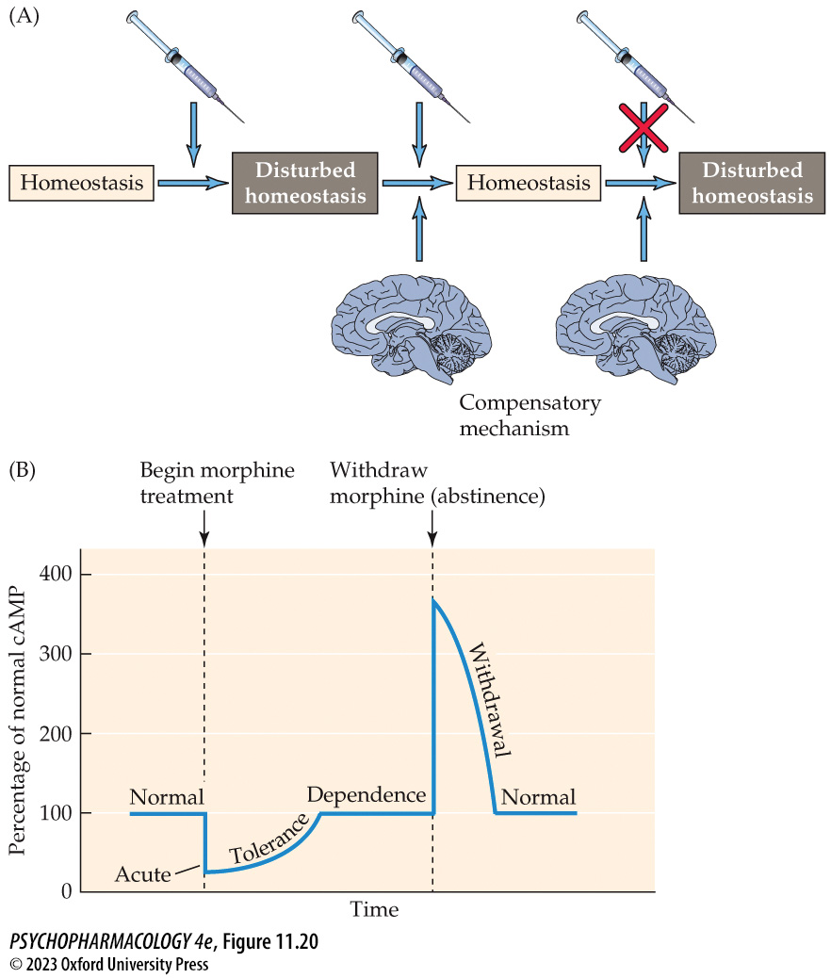
FIGURE 11.20 Model of tolerance and withdrawal
Notes:
FIGURE 11.20 Model of tolerance and withdrawal
(A) Himmelsbach’s theoretical model suggests that the nervous system adapts to the disturbing presence of a drug, so tolerance develops, but if the drug is suddenly withdrawn, the adaptive mechanism continues to function, causing a rebound in physiological effects (withdrawal). (B) Morphine acutely inhibits the synthesis of cAMP, but the effect becomes less as tolerance develops and neural adaptation occurs. If morphine is suddenly withdrawn, a far larger than normal amount of cAMP is produced, suggesting that the adaptive mechanism is still operating. With time, the cells once again adapt, now to the absence of the drug.

Slide 61
Opioid Reinforcement, Tolerance, and Dependence (9 of 15)
Environmental cues have a role in tolerance, drug abuse, and relapse
Environmental cues can be classically conditioned to drug taking.
After repeated administration in the same environment, animals show physiological signs of anticipation in that environment.
Euphoria may be associated with camaraderie of the drug-using subculture, drug acquisition activities and drug injection rituals, which become secondary reinforcers and act as triggers that promote drug taking
A drug addict may find that tolerance is lowered in a new environment, which may contribute to overdosing.
Notes:
Instructor Notes:
Many researchers feel that learning is a critical factor in opioid use disorder.

Slide 62
Opioid Reinforcement, Tolerance, and Dependence (10 of 15)
Treatment programs for opioid use disorder
Treatment requires understanding the multiple contributors to the problem
Most drug treatment programs utilize a biopsychosocial model as the basis for therapy, into account the multidimensional nature of chronic drug use:
  Physiological effects of the drug
  Psychological status and history of drug use
  Environmental factors that act as cues
Notes:
Instructor Notes:

Slide 63
Opioid Reinforcement, Tolerance, and Dependence (11 of 15)
Detoxification is the first step in the therapeutic process
Can be assisted by long-acting opioids, e.g., methadone – reduces symptoms to a comfortable level
Clonidine: (α2-adrenergic agonist), acts on noradrenergic autoreceptors to reduce NE activity in the locus coeruleus
Electroacupuncture is an alternative
Notes:
Instructor Notes:

Slide 64
Opioid Reinforcement, Tolerance, and Dependence (12 of 15)
Treatment goals and programs rely on pharmacological support and counseling
Methadone maintenance program: most common and effective treatment for heroin addiction
Methadone has cross-dependence with heroin – prevents severe withdrawal symptoms; reduces euphoric effect of heroin.
Programs require daily supervised oral administration; reduces use of the needle and its ritual; reduces risk of unsterile needles
Notes:
Instructor Notes:

Slide 65
Opioid Reinforcement, Tolerance, and Dependence (13 of 15)
Treatment goals and programs rely on pharmacological support and counseling
Buprenorphine (Buprenex): opioid partial agonist used in the same way as methadone
Compared with psychological treatments alone or managed tapering off of opiate use, long-term maintenance with opioid agonists produces better treatment outcomes
Notes:
Instructor Notes:
Suboxone: Buprenorphine plus naloxone. When taken sublingually, the buprenorphine is absorbed but the naloxone is not. If the tablet is crushed and injected, the naloxone blocks buprenorphine’s euphoric effects.

Slide 66
Opioid Reinforcement, Tolerance, and Dependence (14 of 15)
Treatment goals and programs rely on pharmacological support and counseling
Narcotic antagonists such as Naltrexone (Trexan) and Nalmefene (Revex) are used in some programs; requires a great deal of motivation
Vaccines would produce antibodies to bind to the drug and prevent entry to the brain; no clinical trials yet
Medication-assisted treatment: a combination of detoxification, pharmacological support, and group or individual counseling
Notes:
Instructor Notes:

Slide 67
Opioid Reinforcement, Tolerance, and Dependence (15 of 15)
CLICKER QUESTION 3
Studies of reinforcement suggest that opioid drugs produce their effects by inhibiting
dynorphin.
dopamine.
GABA.
β-endorphin.
Notes:
Instructor Notes:
Correct answer: c

Slide 68
Review of Learning Objectives (3 of 3)
11.3.1 Describe the evidence showing that opioid drugs exert highly reinforcing effects in both humans and non-human animals.
11.3.2 Describe the neural circuitry that underlies the reinforcing effects of opioids.
11.3.3 Explain how tolerance and physical dependence develop and describe the neural mechanisms that explain these phenomena.
11.3.4 Describe how pharmacotherapy with methadone or buprenorphine works to help individuals with opioid use disorder remain abstinent.
11.3.5 Explain how new approaches to preventing and treating opioid use disorder, such as compounding opioids with antagonists, or opioid vaccines, may be effective.

